Slide 1

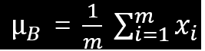
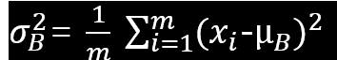
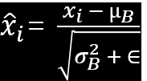
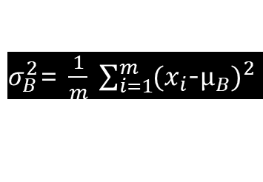

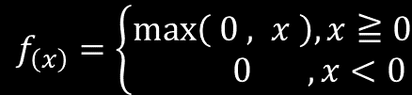
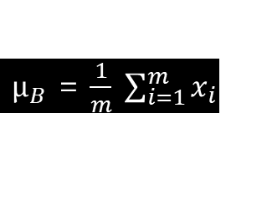
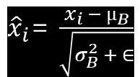
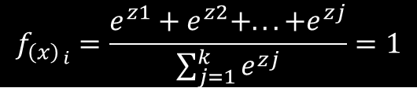

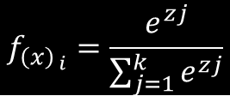
$f_{\left(x\right)}$ = $\frac{1}{{1 +e}^{−x}}$
$z_{i}$ = $γ{\hat{x}}_{i}$ + $β$
$f_{\left(x\right)}=\left\{\begin{matrix}\max\left( 0 , x \right), x≧0 \\ 0 ,x<0\end{matrix}\right.$
$$f_{{\left(x\right)}_{ i}}=\frac{e^{zj}}{\sum_{j=1}^{k}{e^{zj}}}$$
$$f_{{\left(x\right)}_{ i}}=\frac{e^{z1}+e^{z2}+...+e^{zj}}{\sum_{j=1}^{k}{e^{zj}}}=1$$
$µ_{B}$ = $\frac{1}{m} \sum_{i=1}^{m}{x_{i}}$
$σ_{B}^{2}$= $\frac{1}{m} \sum_{i=1}^{m}{(x_{i}}$-$µ_{B})^{2}$
${\hat{x}}_{i}$= $\frac{x_{i} − µ_{B}}{\sqrt{σ_{B}^{2} + ∈}}$

Slide 2
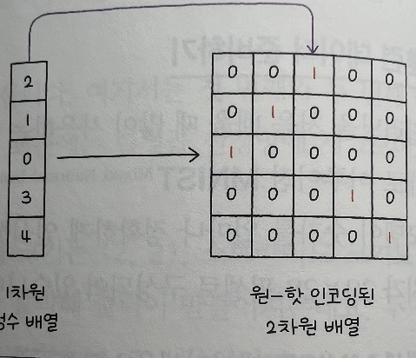
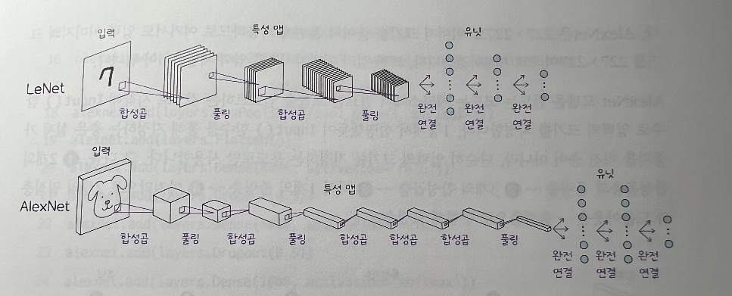
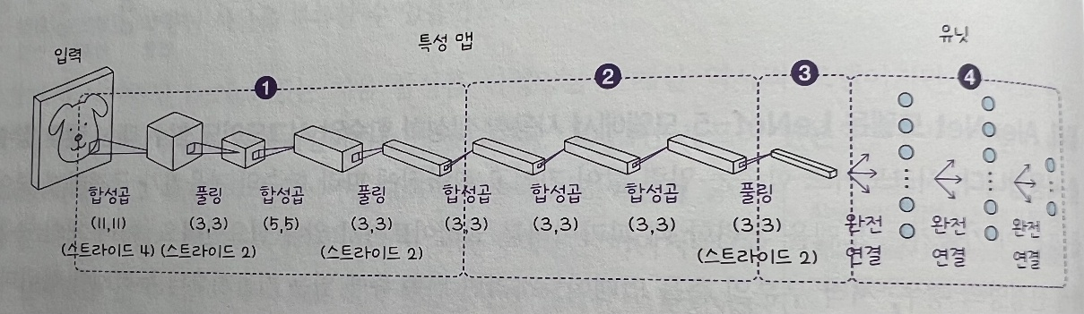
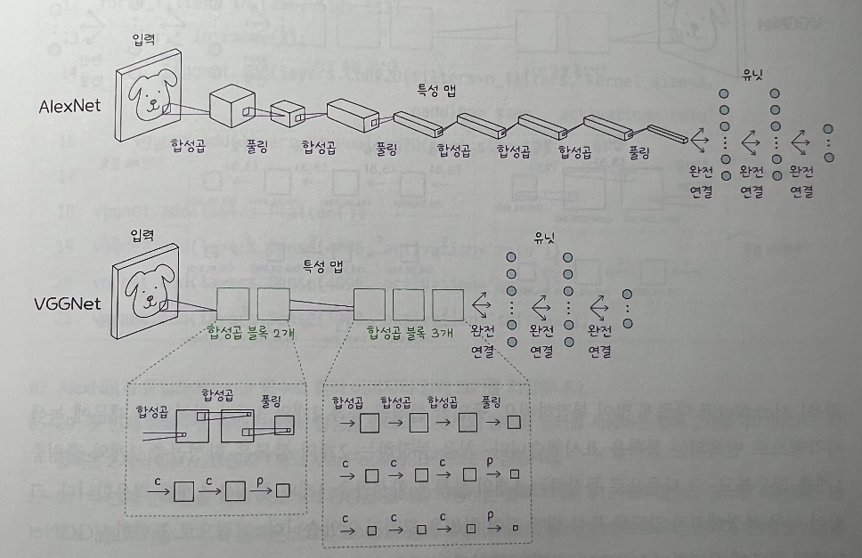

Slide 3
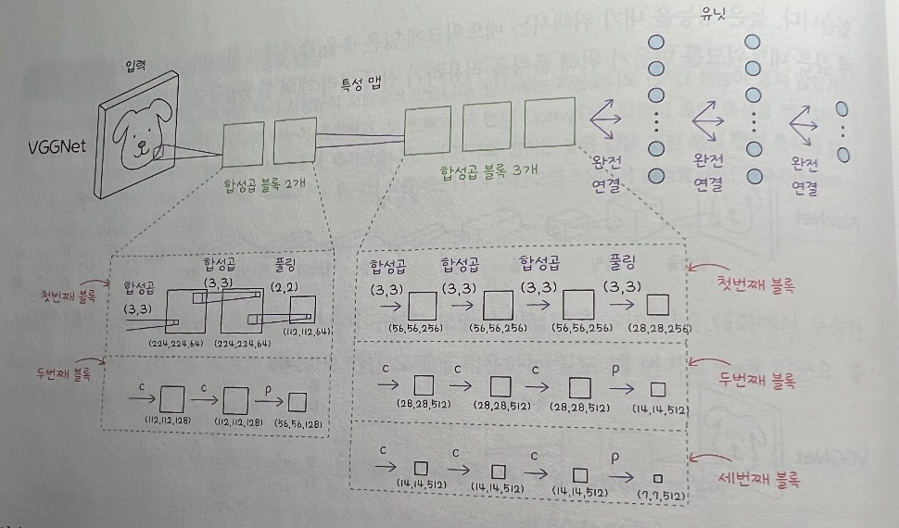
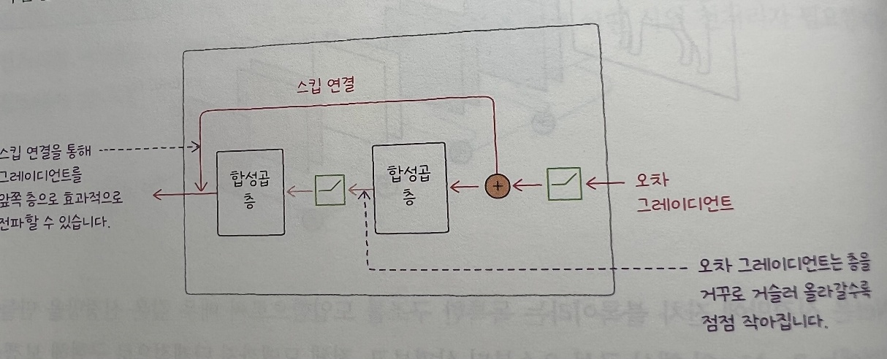
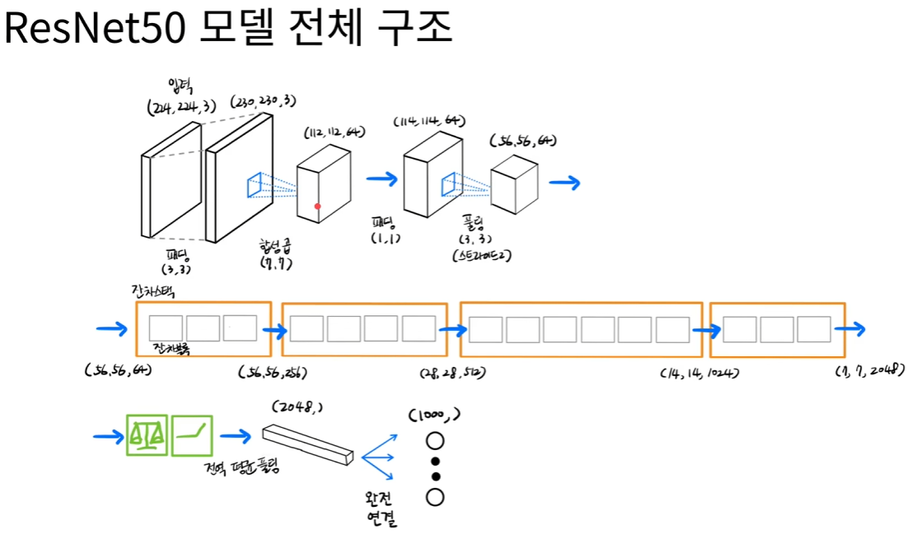

Slide 4
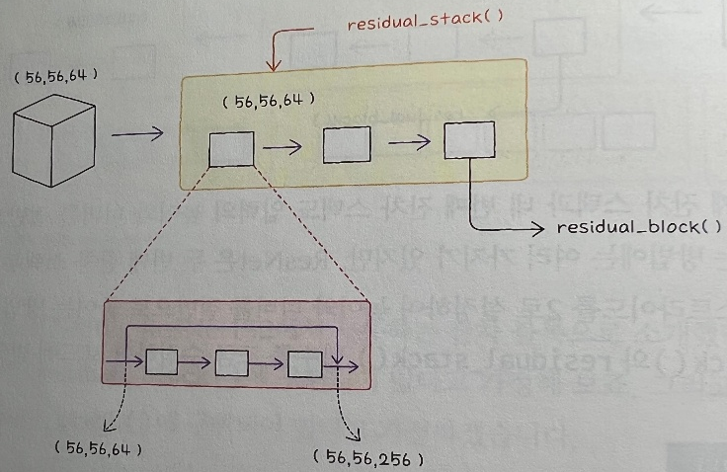
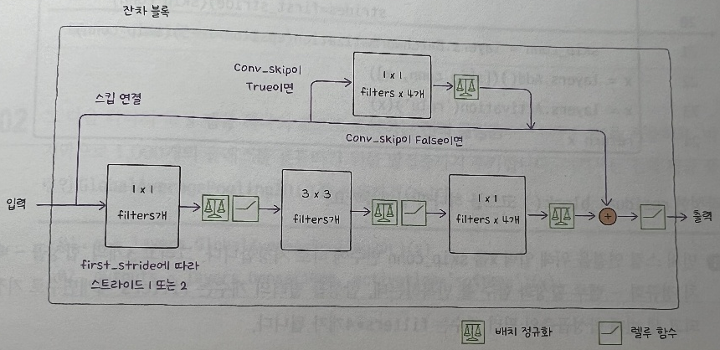
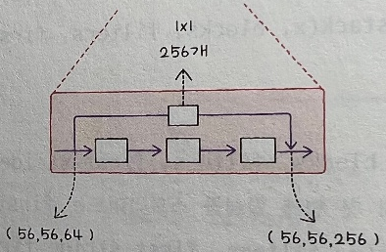

Slide 5
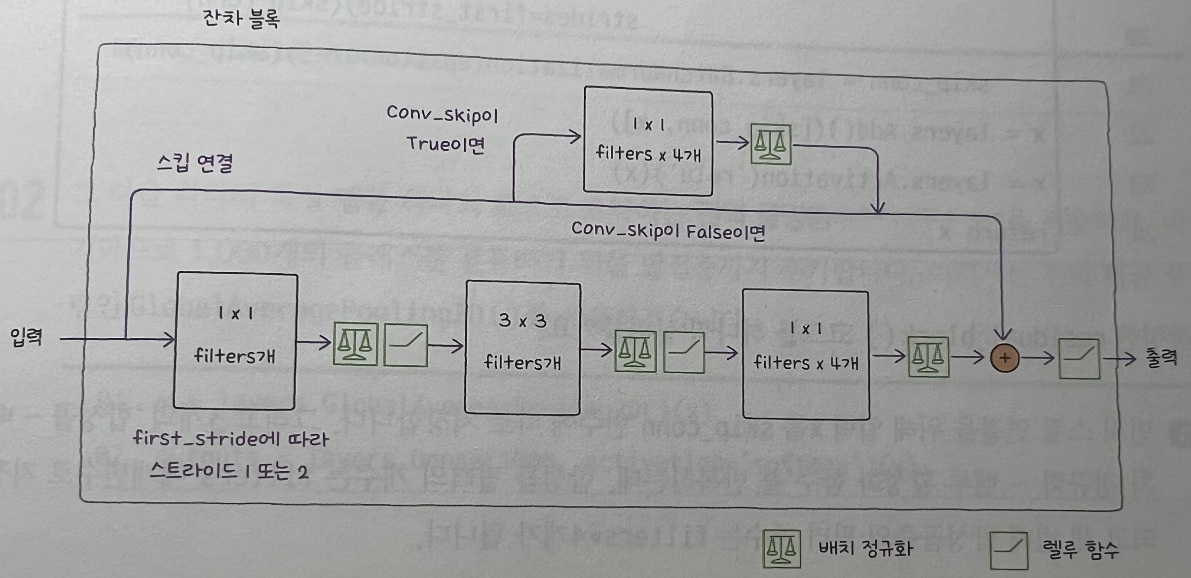

Slide 6
